Slide 1
WELCOME TO THE CREATION OF GUI CALCULATOR
WE WILL STUDY HOW TO PROGRAM A GUI CALCULATOR STEP BY STEPS USING PYTHON IN VS CODE.
presented by:
Safdarulhaq kp

Slide 2
The things you must ensure:
You can create gui calculator by many programming languages, here we are gonna to study using python.
The first step:
Installing python from its website for free.
Then you have to install “visual studio code”, its famous in its abbreviation “VS CODE”.

Slide 3
What is the GUI calculator
A GUI (Graphical User Interface) Calculator is a digital calculator that provides a visual interface for users to perform mathematical operations using buttons and a display screen, instead of typing commands in a text-based interface. It is typically built using GUI frameworks like Tkinter (Python), PyQt, Kivy, Java Swing, or C# Windows Forms.

Slide 4
We can create gui calculator as a simple calculator or Scientific calculator.
Here, I made simple calculator using tkinter library of python in Visual Studio Code.
This is the best and simple way to create Gui calculator
Let’s , move ahead to study , how to create Gui calculator.

Slide 5
Setting Up the Main Window
import tkinter as tk
from tkinter import font
root = tk.Tk()
root.title("Built By Safdar")
root.geometry("300x450")
root.configure(bg="black")
Explanation:
Import Tkinter Create a main window
Set title, size, and background color
Slide Visual: Screenshot of a blank Tkinter window

Slide 6
Creating the Display Screen
def append_to_display(symbol):
current = display.get()
display.delete(0, tk.END)
display.insert(0, current + symbol)
Explanation:
Gets current value in the display Appends new numbers/symbols
Slide Visual: Show how numbers appear when clicking buttons.

Slide 7
Handling Button Clicks
def clear():
display.delete(0, tk.END)
def backspace():
current = display.get()
display.delete(0, tk.END)
display.insert(0, current[:-1])
Explanation:
Clear(): Deletes everything on the display
Backspace(): deletes the last character

Slide 8
ON/OFF Functionality
def on():
display.config(state="normal")
display.delete(0, tk.END)
for button in all_buttons:
button.config(state="normal")
def off():
display.config(state="disabled")
for button in all_buttons:
button.config(state="disabled")
Explanation:
On : enables all button
Off : disables all button

Slide 9
Creating the Buttons
buttons = [
('C', 1, 0), ('←', 1, 1), ('=', 1, 2), ("ON", 1, 3),
('7', 2, 0), ('8', 2, 1), ('9', 2, 2), ('/', 2, 3),
('4', 3, 0), ('5', 3, 1), ('6', 3, 2), ('*', 3, 3),
('1', 4, 0), ('2', 4, 1), ('3', 4, 2), ('-', 4, 3),
('0', 5, 0), ('.', 5, 1), ('+', 5, 2), ('OFF', 5, 3)
]
Explanation:
Defines button labels and positions.
Each tuple = (text, row, column)

Slide 10
Placing Buttons in Grid
for (text, row, col) in buttons:
btn = tk.Button(root, text=text, font=button_font, bg="#e0e0e0", fg="#000000",
command=lambda value=text: append_to_display(value))
btn.grid(row=row, column=col, padx=5, pady=5, sticky="nsew")
all_buttons.append(btn)
Explanation:
Loops through buttons list
Creates Tkinter buttons dynamically
Uses grid layout

Slide 11
Making Grid Responsive
for i in range(6):
root.grid_rowconfigure(i, weight=1)
for j in range(4):
root.grid_columnconfigure(j, weight=1)
Explanatioin:
Ensures buttons expand when resizing the window

Slide 12
Running the Application
root.mainloop()
Explanation:
root.mainloop() starts the Tkinter event loop.
Keeps the calculator running.

Slide 13
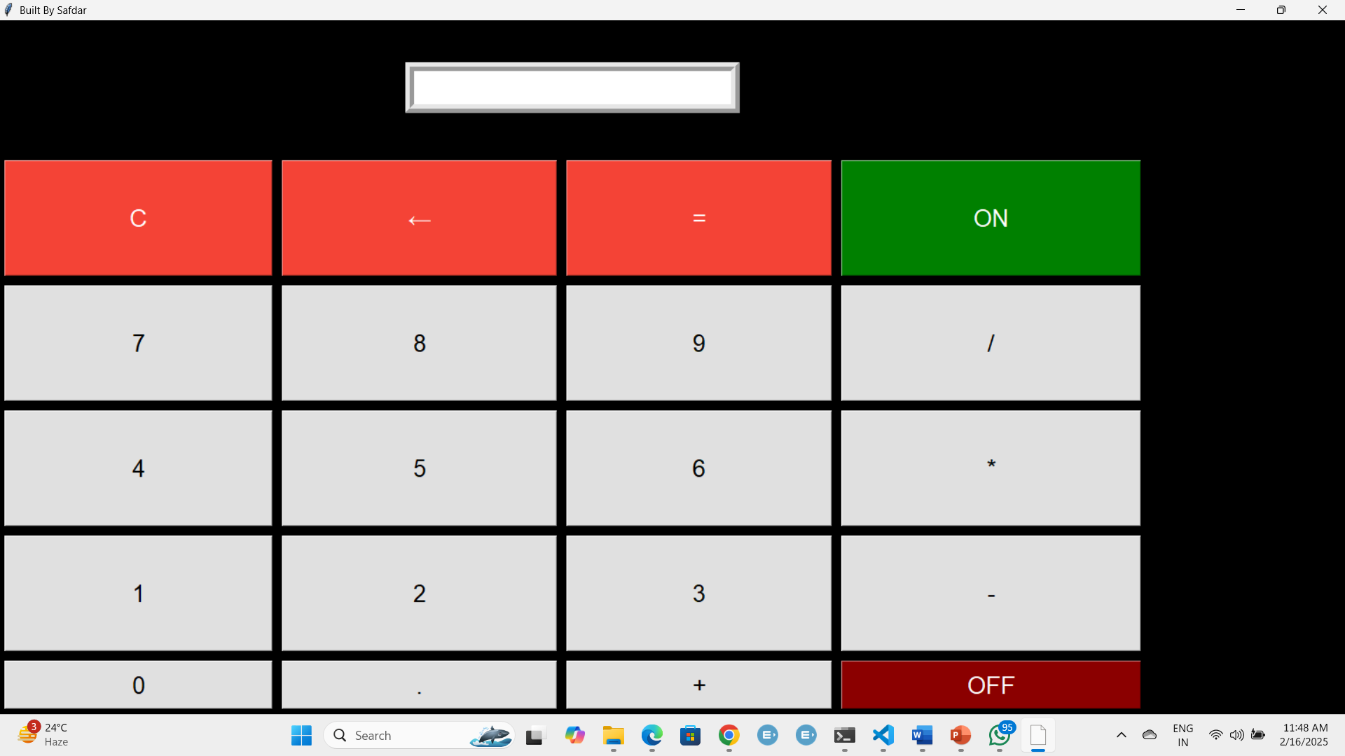


First view
Second view
Third view

Slide 14
conclusion
Tkinter makes GUI development easy. We created a functional calculator. Implemented ON/OFF, backspace, and arithmetic operations.
Slide Visual: Show final calculator with example calculation.

Slide 15
Thank you

